Slide 1
Research Update
13 Jan 2023
Evan Sidrow

Slide 2
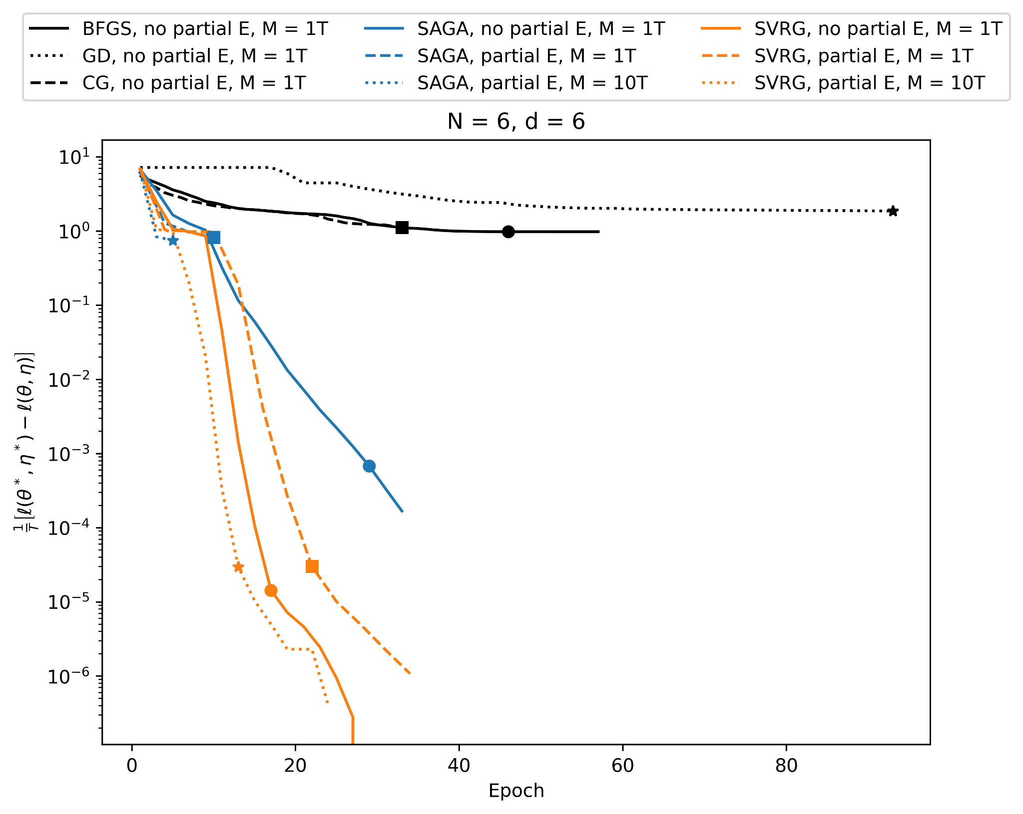
Chapter 2: Faster inference for HMMs

Slide 3
Current Status: Killer whale activity budget
Features:
Max depth
Dive duration
Post dive interval
Different models for males and females
7 dive types
Resting (shallow + deep)
Travelling (shallow + deep)
Foraging (shallow + deep)
Logging
Use observations / depth to label dives

Slide 4
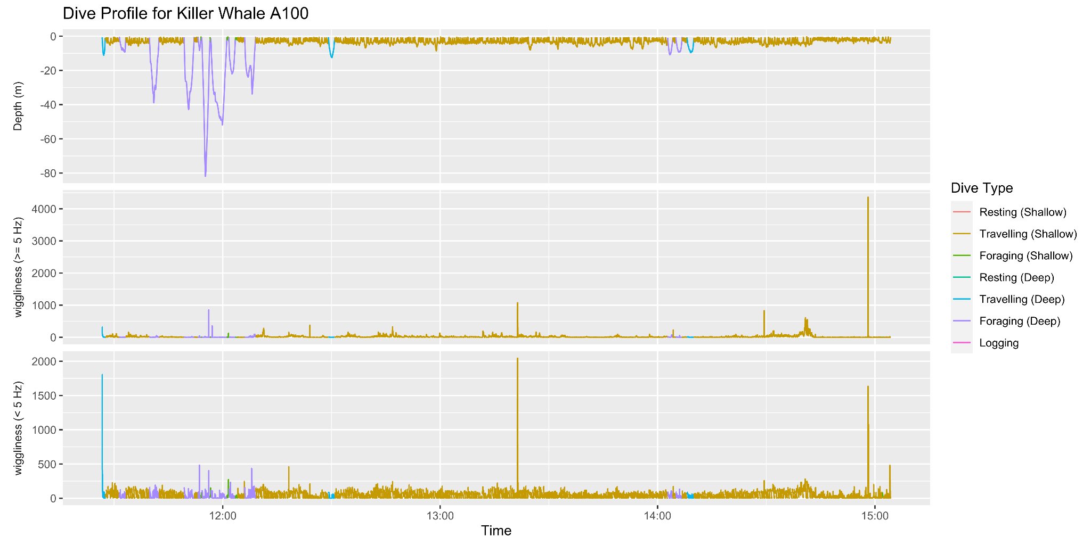

Slide 5
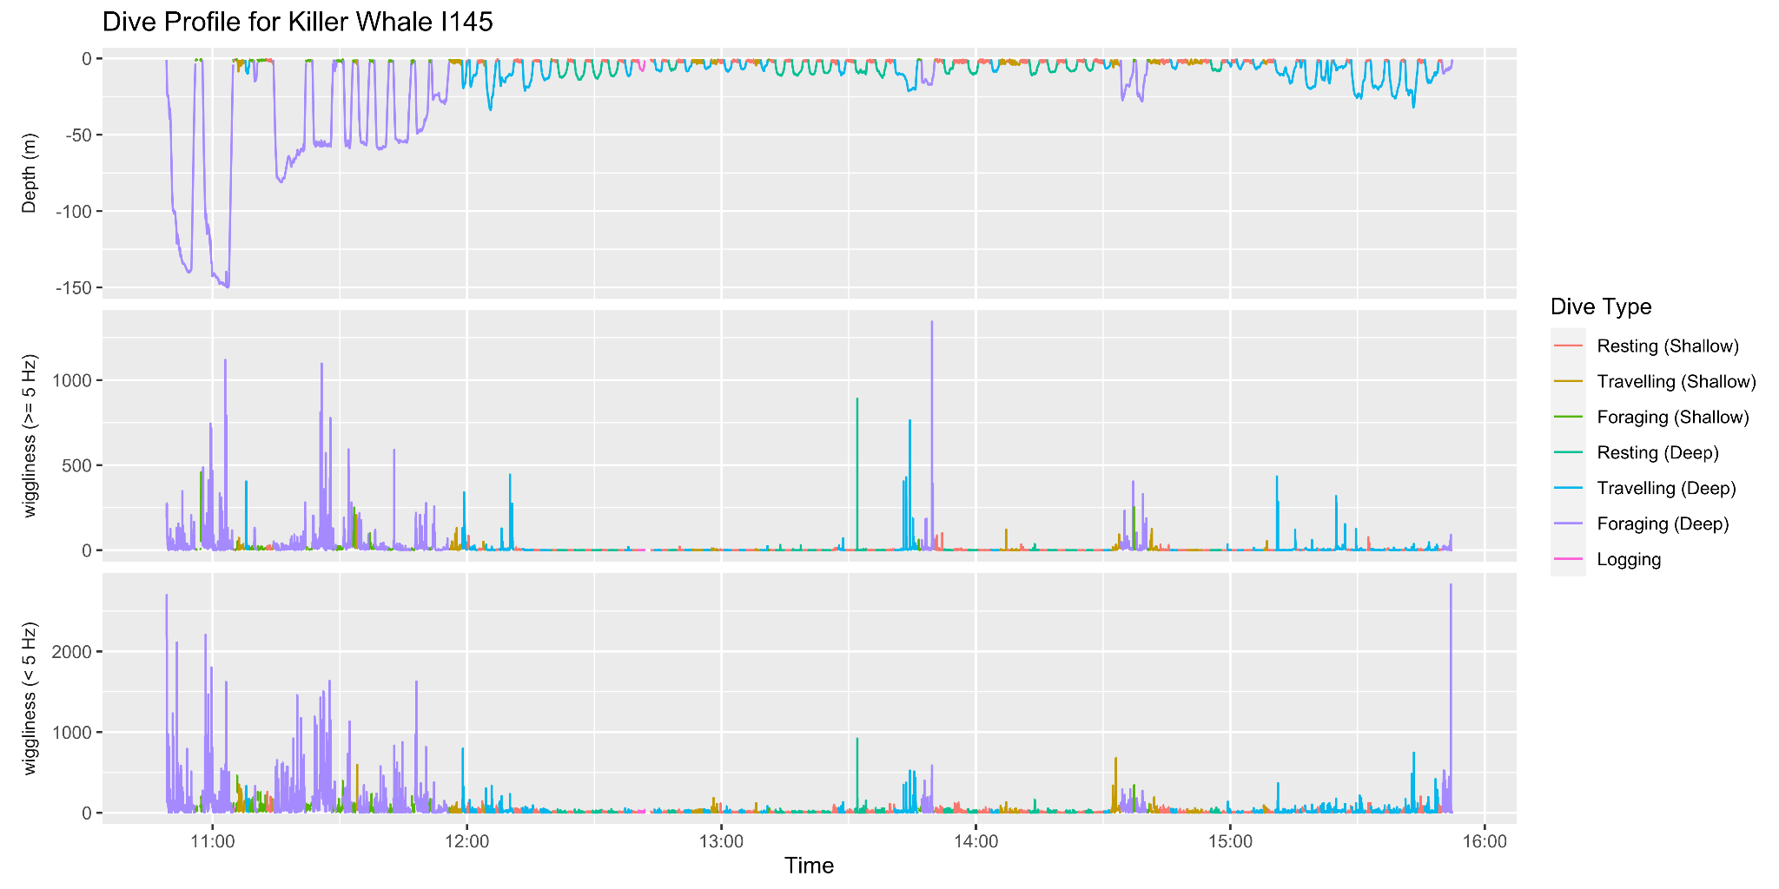

Slide 6
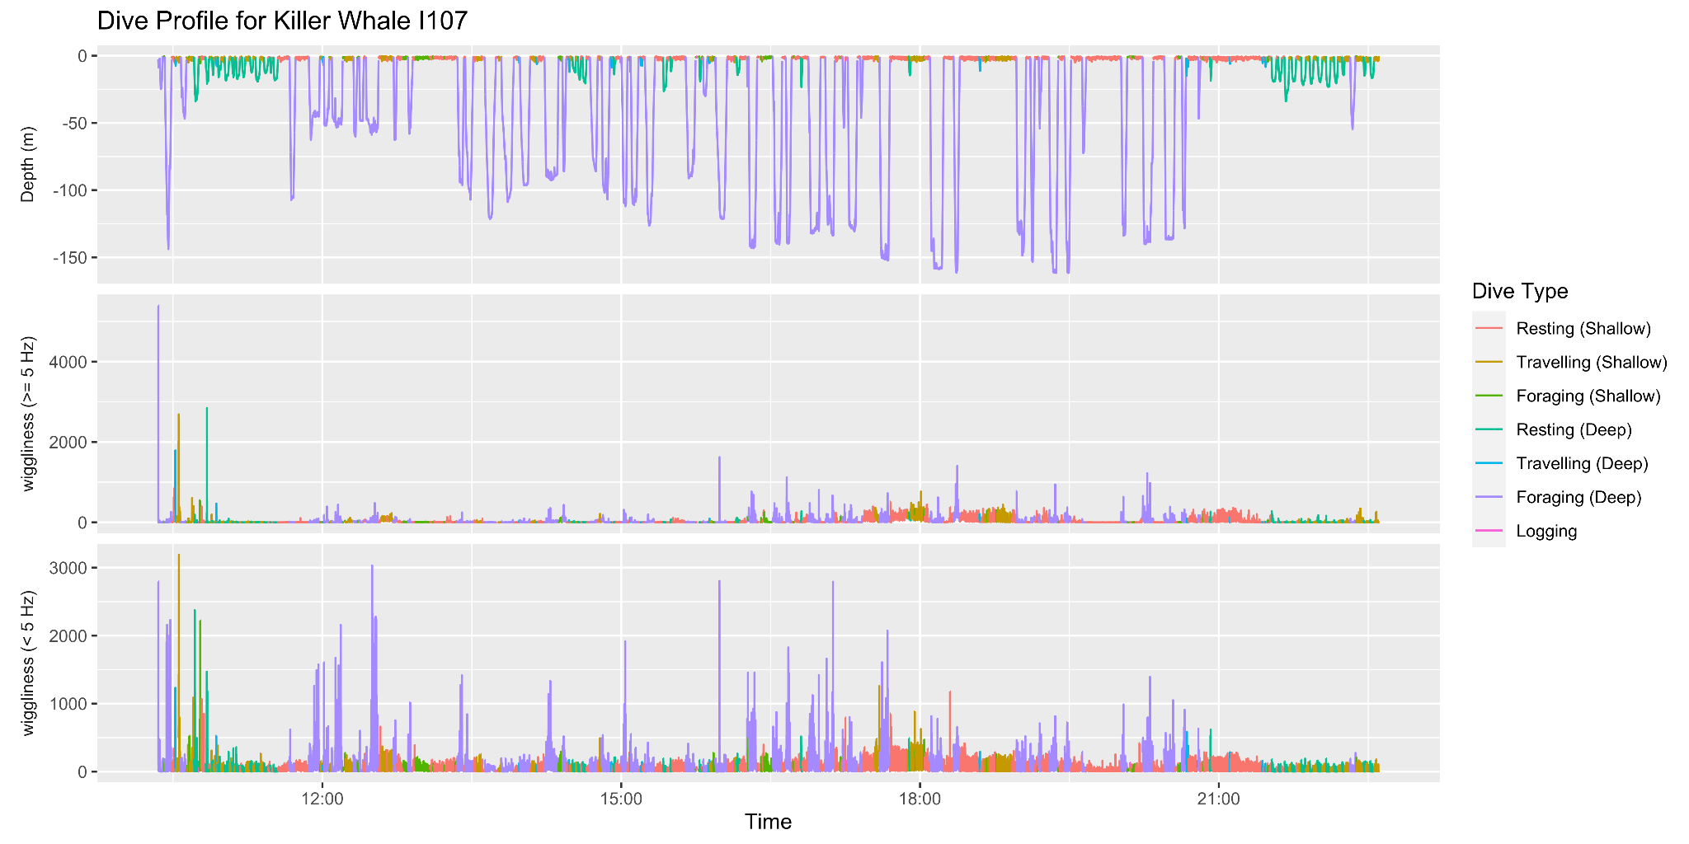

Slide 7
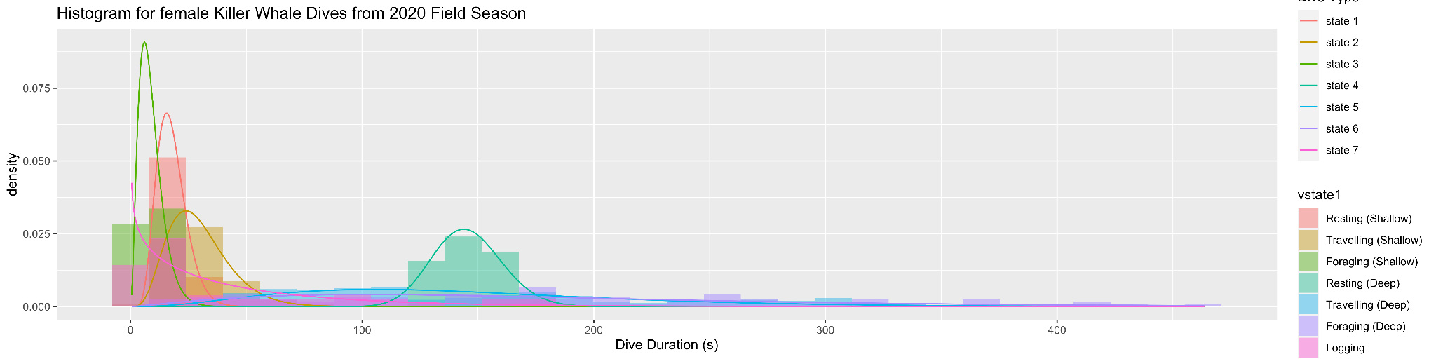
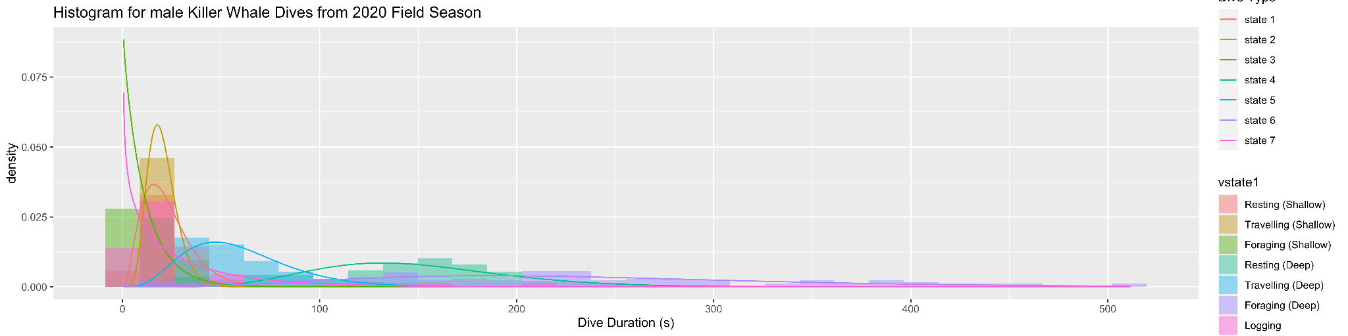

Slide 8
Questions / Concerns
No state interpretation in HMM
(553 / 8118) dives are labeled
Shallow dive types are similar
Behaviours on bout level, not dive level

Slide 9
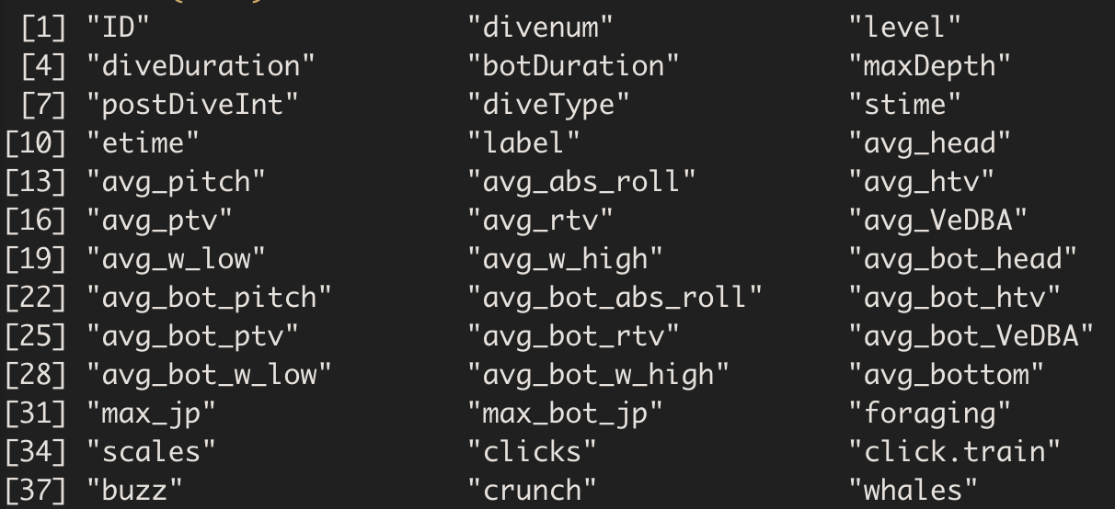
Future work
What features to use?
Hierarchical HMM?
Labels depend upon dive type?
Include accelerometer data?
ecology vs statistics paper?

